Slide 1
Topics will Be Covered:
Capacitor, Capacitance
Types of Capacitor, Applications of Capacitor
Capacitance Based on Physical Dimension
Transients in Capacitive Networks
Charging and Discharging in a Capacitor
Capacitors in Series and Parallel

Slide 2
Chapter 10
Capacitors

Slide 3
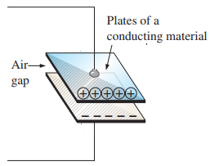
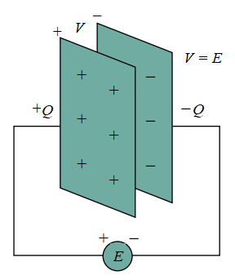
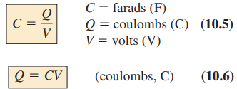
10.4 Capacitor
Capacitor:
A capacitor is a passive element that is constructed simply of two conducting surfaces or plats separated by the air gap or insulator or dielectric materials. Capacitor is also called condenser.
Capacitance:
Capacitance is a measure the ability of a capacitor to store charge on its plates as well as to oppose the rate of change of voltage (dv/dt). Unit of capacitance is Farad (F).
The higher the capacitance of a capacitor, the greater the amount of charge stored on the plates for the same applied voltage.
Relationship among the applied voltage (E=V), the charge on the plates (Q), and the capacitance level (C):
Capacitance is the ratio of the charge (Q) in one plate of a capacitor to the voltage difference (V) between the two plates.
3

Slide 4

Problem 3 [P453] Find the capacitance of a parallel plate capacitor if 1200 µC of charge are deposited on its plates when 10 V are applied across the plates.
Solution: Q = 1200 µC = 1200×10⁻⁶ µC, V = 10 V
We know that:
Problem 4 [P453] How much charge is deposited on the plates of a 0.15 µF capacitor if 45 V are applied across the capacitor?
Solution: C = 0.15 µF = 0.15 ×10⁻⁶ µF, V = 45 V
We know that:
Practice Example 10.1
4

Slide 5
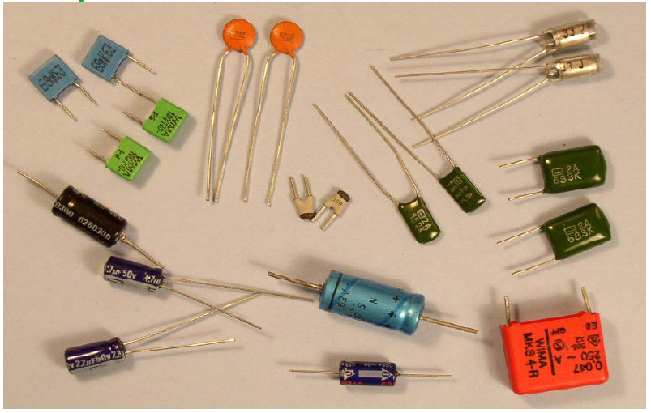
Different Types of Capacitors
Applications of Capacitor:
Limit rate of change of voltage
Radio Receiver
Block dc
Pass ac
Shift phase
Store energy
Start motors
Suppress noise
Filter Circuits
Improve power factor

Slide 6
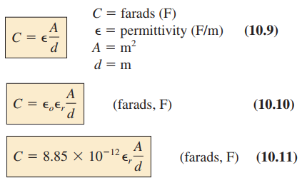


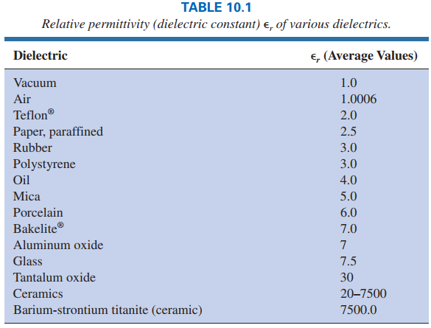
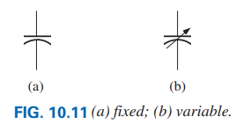
Capacitance Based on Physical Dimension
Equation of Capacitance:
Let, C_{o} is the value of capacitance considering air as a dielectric material and C is the value of capacitance for any other dielectric material, then we have
∈_{o} = 8.85 × 10⁻¹² [F/m] and ∈_{r} is called the relative permittivity.
6

Slide 7

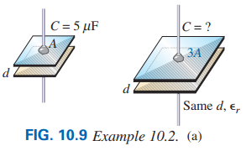
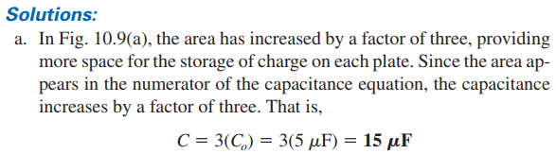
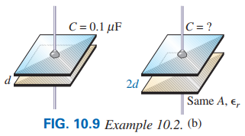
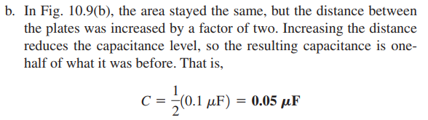
EXAMPLE 10.2 In Fig. 10.9(a) and (b), if each air capacitor in the left column is changed to the type appearing in the right column, find the new capacitance level. For each change, the other factors remain the same.
7

Slide 8
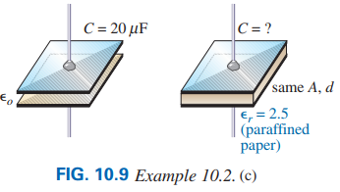
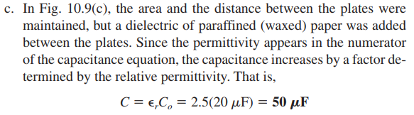
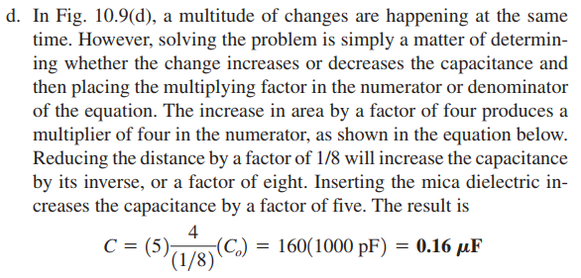
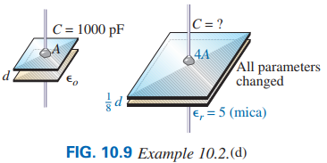
EXAMPLE 10.2 In Fig. 10.9(c) and (d), if each air capacitor in the left column is changed to the type appearing in the right column, find the new capacitance level. For each change, the other factors remain the same.
Practice Problem 14 [P453]
8

Slide 9
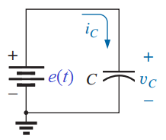
10.5 TRANSIENTS IN CAPACITIVE NETWORKS
If the applied voltage is change with respect to time the storage charge and current are also change in a capacitor. The changeable voltage, current and charge are represented by small letter i.e. v, i and q.
Combining Eq. (10.6.1) and Eq. (2.5.1) we have:
Eq. (10.6) can be written as follows where voltage (v) and charge (q) are changing with respect to time:
By integrating Eq. (10.5.1) in both sides we have:
Similarly, Eq. (2.5) can be written as follows where current (i) and charge (q) are changing with respect to time:
Energy storage by a capacitor can be calculated as follows:
9

Slide 10
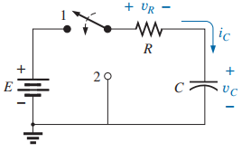
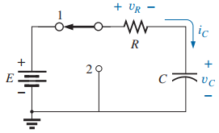
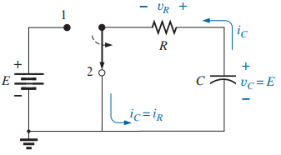
Charging and Discharging in a Capacitor
In Figure 10.39(a):
Charging Mode: When the switch is in position 1 as shown in Figure 10.39 (b), capacitor is stored the charge.
Discharging Mode: When the switch is in position 2 as shown in Figure 10.39 (c), capacitor is released the charge through the resistor.
The solution of Eq. (i) is as follows:
Substitute Eq. (10.13) into Eq. (10.5.1), we have:
Figure 10.39 (a)
The voltage drop across the resistor will be:
Charging Mode of Fig. 10.39(a): According to KVL we have:
Figure 10.39 (b)
The quantity τ is called time constant, which is given by:
Prove that the unit of τ = RC is seconds.
Figure 10.39 (c)
10

Slide 11
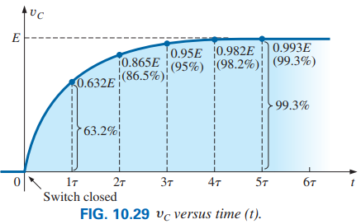
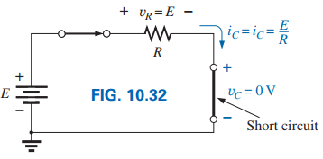
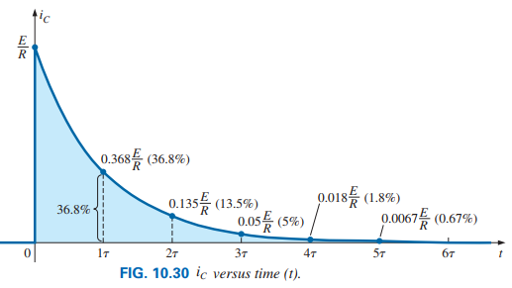
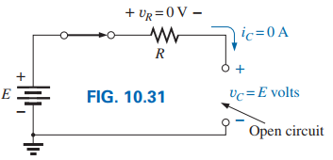
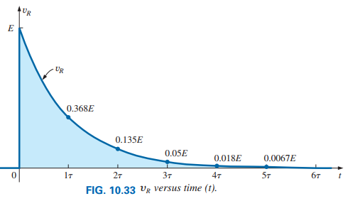
At time t = 0 (at the instant of switch is closed), from Eqs. (10.13) and (10.15) we have:
It has been observed from graphs of Figures 10.29 and 10.30 that at t = 5τ, the capacitor voltage becomes almost equal to supply voltage and the current becomes almost zero.
At time t = ∞ (steady-state condition), from Eqs. (10.13) and (10.15) we have:
The transient or charging phase of a capacitor has essentially ended after five time constants.
After five time constants, circuit in steady state.
11

Slide 12
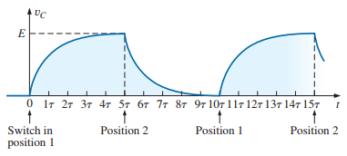
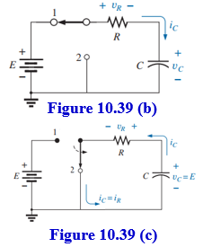
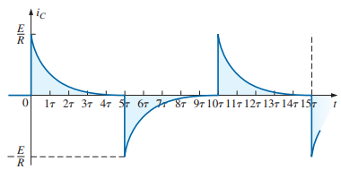
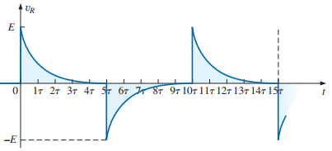
Discharging Phase
Charging
Discharging
Charging
Figure 10.39(c)
According to KVL we have:
The solution of Eq. (ii) is as follows:
It has been observed from Figure 10.39(b) with Figure 10.39(c), the direction of current i_{C} and the polarity of voltage v_{R} are opposite in discharging mode as compare with charging mode.
Substitute Eq. (10.17) into Eq. (10.5.1), we have:
The voltage drop across the resistor will be:
12

Slide 13

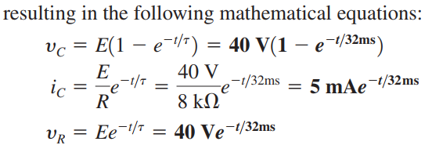
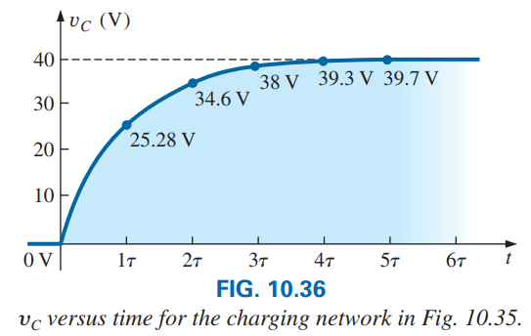
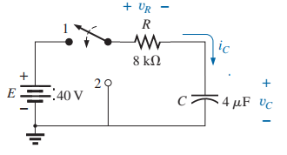
EXAMPLE 10.6 For the circuit in Fig. 10.35:
a. Find the mathematical expression for the transient behavior of v_{C}, i_{C}, and v_{R} if the switch is closed at t = 0 s.
b. Plot the waveform of v_{C} versus the time constant of the network.
c. Plot the waveforms of i_{C} and v_{R} versus the time constant of the network.
d. What is the value of v_{C} at t = 20 ms?
e. On a practical basis, how much time must pass before we can assume that the charging phase has passed?
f. When the charging phase has passed, how much charge is sitting on the plates?
Solution: Given, E = 40 V, R = 8×10³ Ω, and C = 4×10⁻⁶ F,
Figure 10.35
13

Slide 14

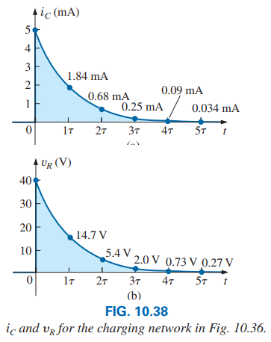
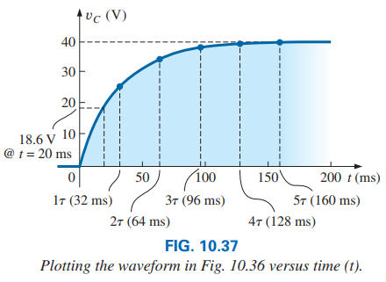
14

Slide 15



15

Slide 16
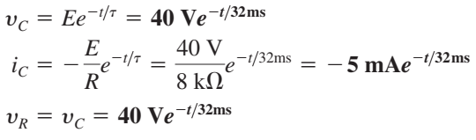
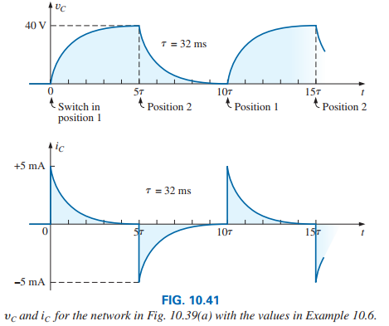
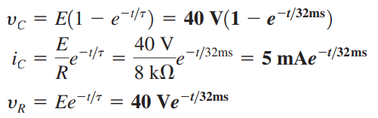
EXAMPLE 10.7 Plot the waveforms for v_{C} and i_{C} resulting from switching between contacts 1 and 2 in the following figure every five time constants.
Discharging Mode:
Solution: Given, E = 40 V, R = 8×10³ Ω, and C = 4×10⁻⁶ F
Charging Mode:
16

Slide 17
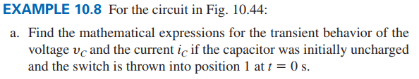
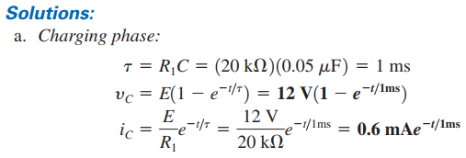

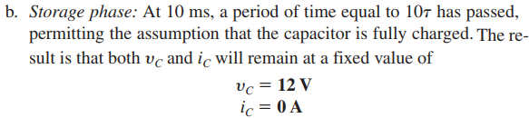
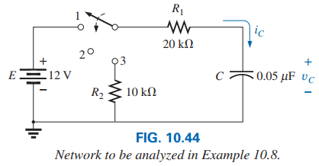
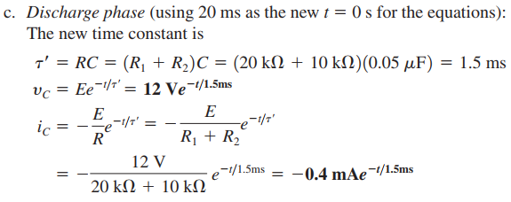
17

Slide 18
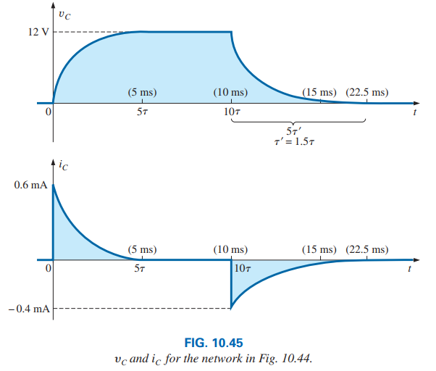

18

Slide 19
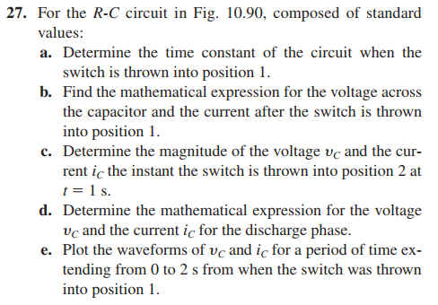
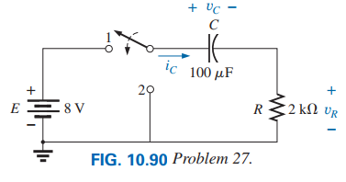
Solution: Given, E = 8 V, R = 2×10³ Ω, and C = 100×10⁻⁶ F
19

Slide 20

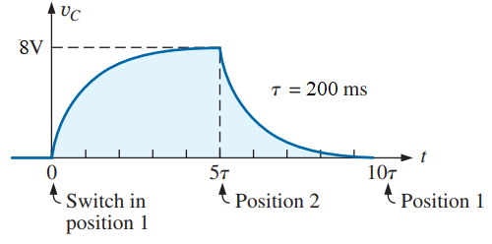
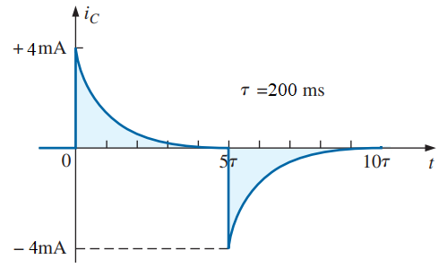
Practice Problems 21 ~ 30 [Ch. 10]
20

Slide 21
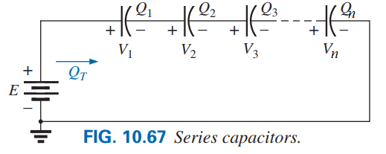
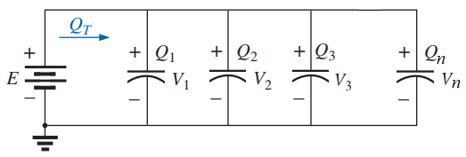
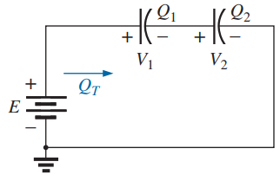
10.11 CAPACITORS IN SERIES AND IN PARALLEL
Parallel capacitors
When two capacitors are connected in series:
21

Slide 22
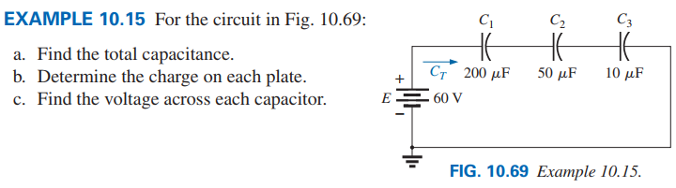



22

Slide 23



23

Slide 24



24

Slide 25


25

